Slide 1

Stay-N-Sleep
Elevated XP

Slide 2

Stay-N-Sleep
Mission
To enable every traveler, to build a community of lifelong travelers, and enable the travel community to experience what matters.
Vision
Connect people, enrich communities and open minds to new experiences and cultures
How do we accomplish this ?
Stay-N-Sleep offers arrangements for lodging and tourism experiences.
We have one of the world’s largest marketplaces for unique, authentic places to stay and things to do, offering over 2 million accommodations and tens of thousands of handcrafted activities, all powered by local hosts.
Notes:
Greetings, colleagues of Stay-N-Sleep,
Today, we come together with a shared mission—to enable every traveler to build a community of lifelong explorers and create unforgettable experiences that truly matter.
At Stay-N-Sleep, our vision is clear—to connect people, enrich communities, and open minds to new adventures and cultures.
Through our world-class marketplace, we offer 2 million unique accommodations and curated activities that ignite wonder and create cherished memories.

Slide 3

Problem to Solve
We need to find a way for customers to be loyal and feel rewarded to return and conduct more business with Stay-N-Sleep.
Notes:
However, we recognize that in today's competitive landscape, we face the crucial task of fostering customer loyalty and ensuring they feel rewarded for choosing us.
The question we must tackle is, "How can we create a loyalty program that not only encourages customers to return but also makes them feel appreciated and valued?"

Slide 4
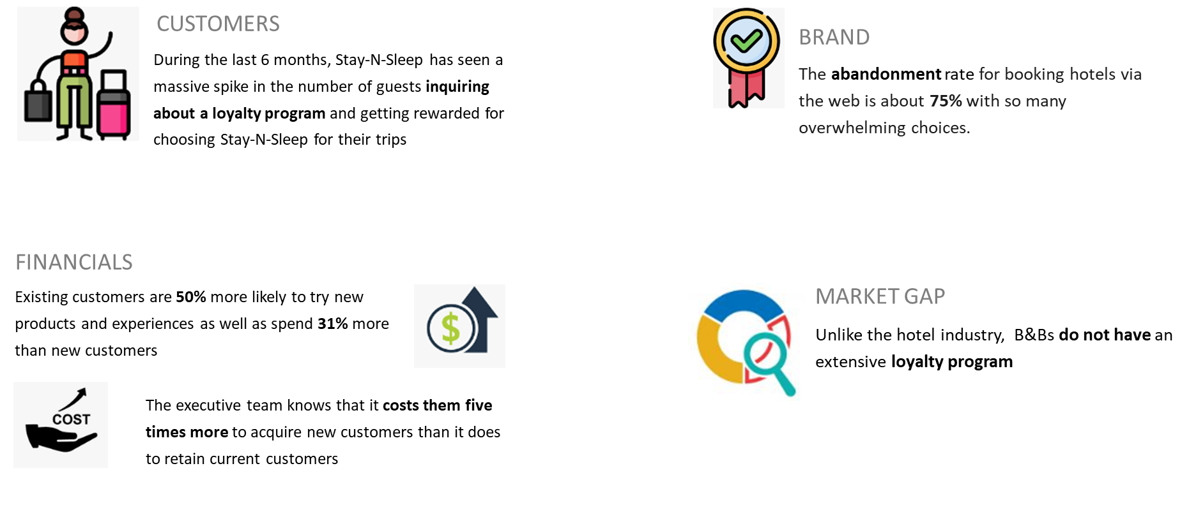
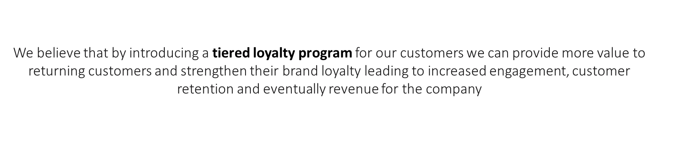
Is this the right opportunity ?
Notes:
Over the last 6 months, Stay-N-Sleep has witnessed a remarkable surge in customer inquiries about a loyalty program. Guests seek recognition and rewards for choosing us as their preferred travel partner.
In today's digital landscape, with a staggering 75% abandonment rate for hotel bookings on the web, the abundance of choices can be overwhelming for customers.
To address this, we propose introducing a tiered loyalty program, which we call: Elevated XP. By implementing this, we can enhance the value we offer to returning customers, nurturing their brand loyalty.

Slide 5
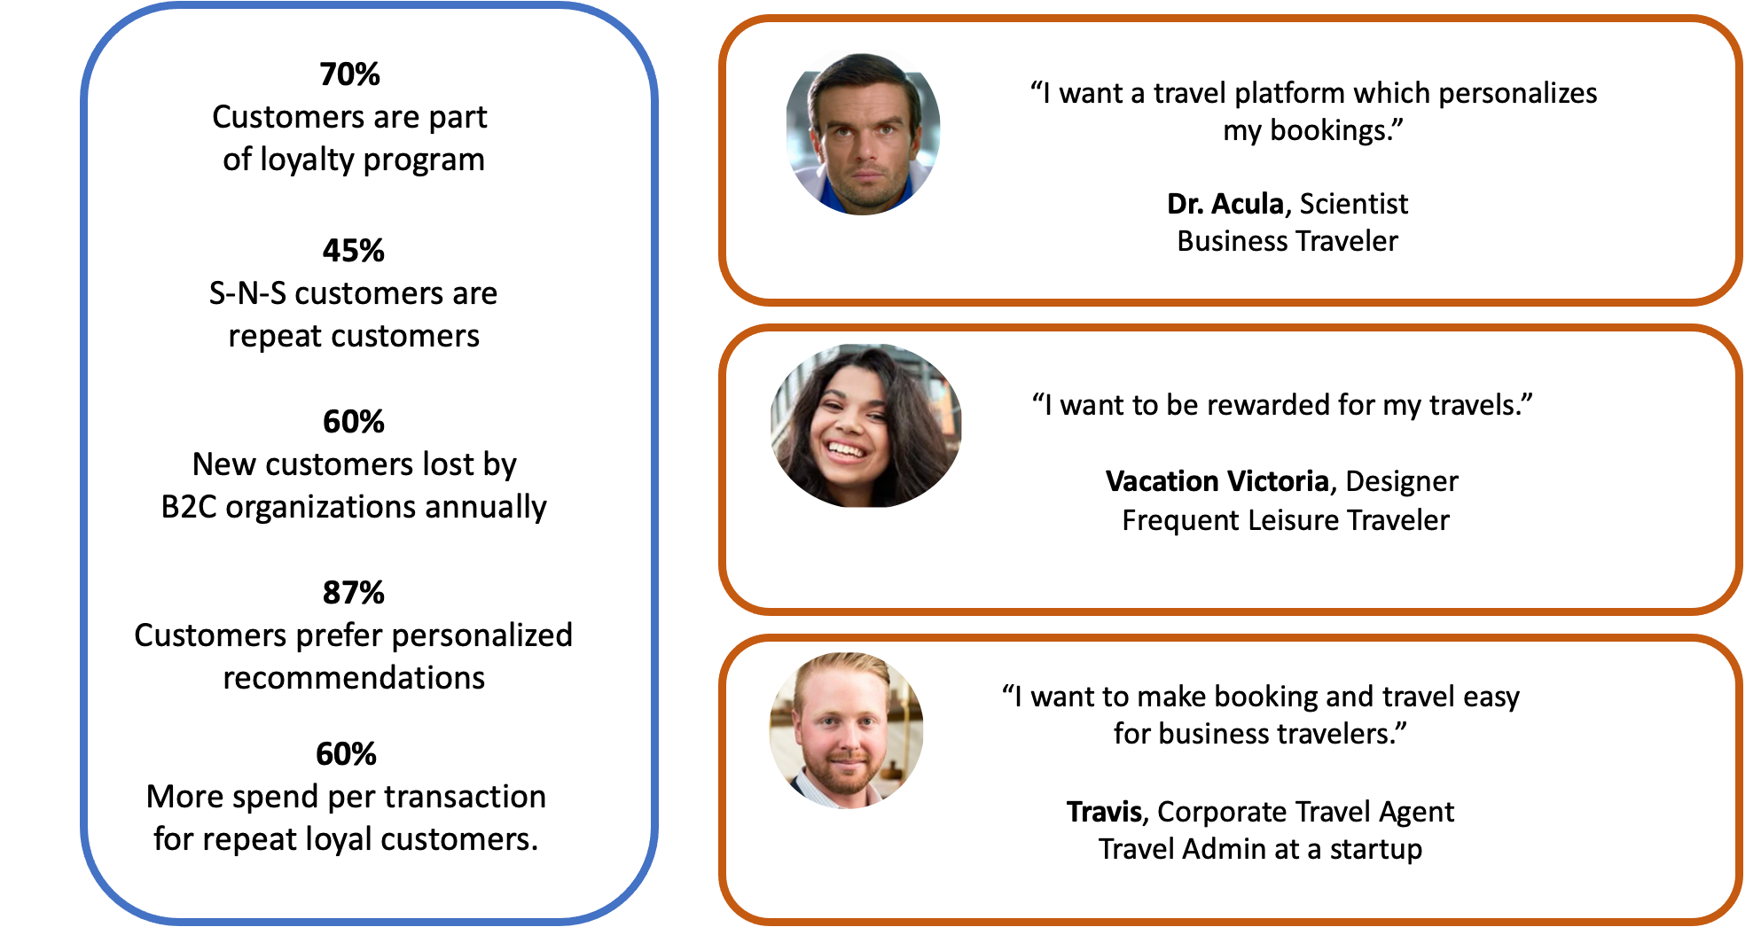
Voice of the customer
Notes:
Now that we have identified product opportunities, we wanted to identify the User personas to cater our product towards.
We identified 3 personas
Business traveler, with a preference for personalization and seamless booking experience.
Frequent Leisure Traveler, with a requirement for getting rewarded for frequent travel.
Travel Admin, with a need to make booking and travel easy for its customers.
For our project we focused on first 2 personas as they seemed to cover most of the market.
Travis is a smaller market segment
We also have detailed user personas and some cool data in our appendix for people to check.

Slide 6
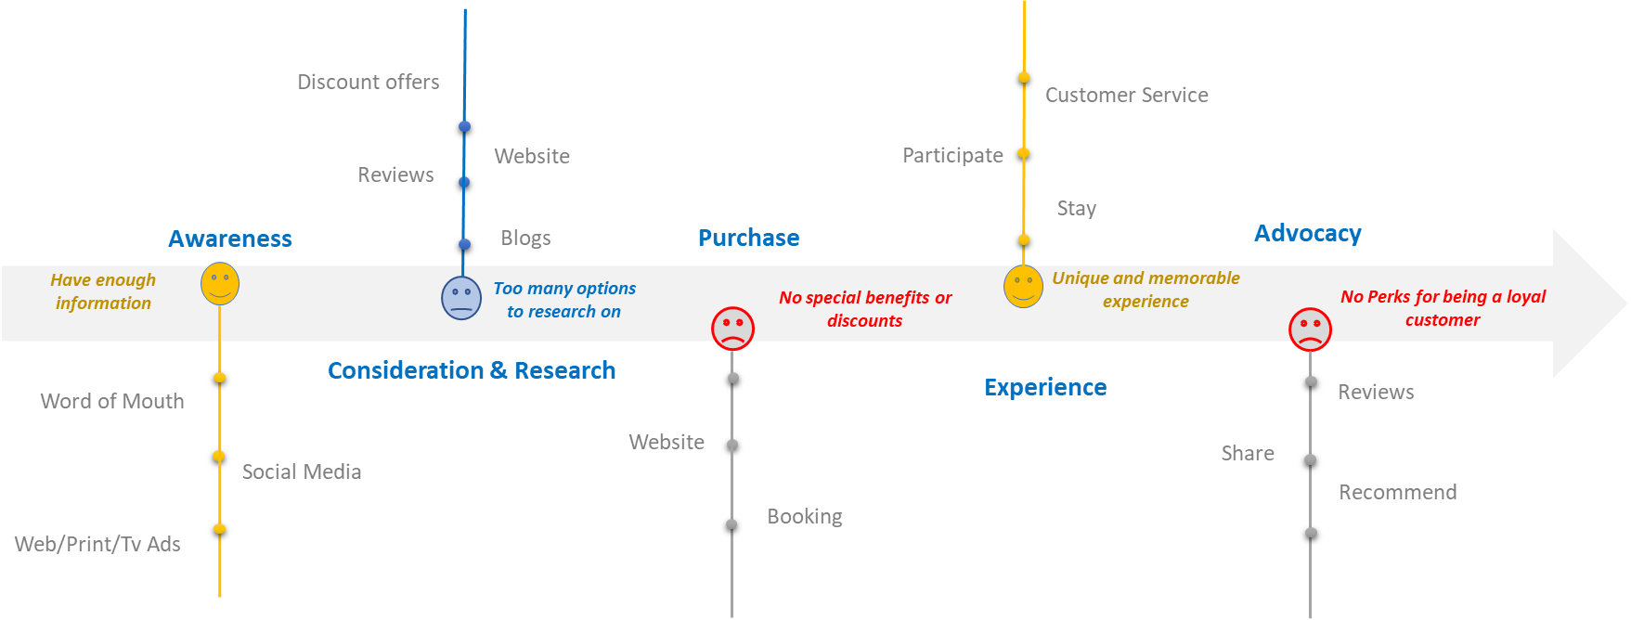
Customer Journey
Notes:
After the User personas, we wanted to chalk out a Customer journey map.
We divided the into 5 sections
We identified 3 sections where we can insert our opportunity and make the customer happy.
Consideration and Research (Too many options to research and choose from)
Purchase (No special benefits or Discounts during bookings)
Advocacy (No perks for brand loyalty)
Targeted marketing
Personalization
Rewards points
Tiered Loyalty Program

Slide 7
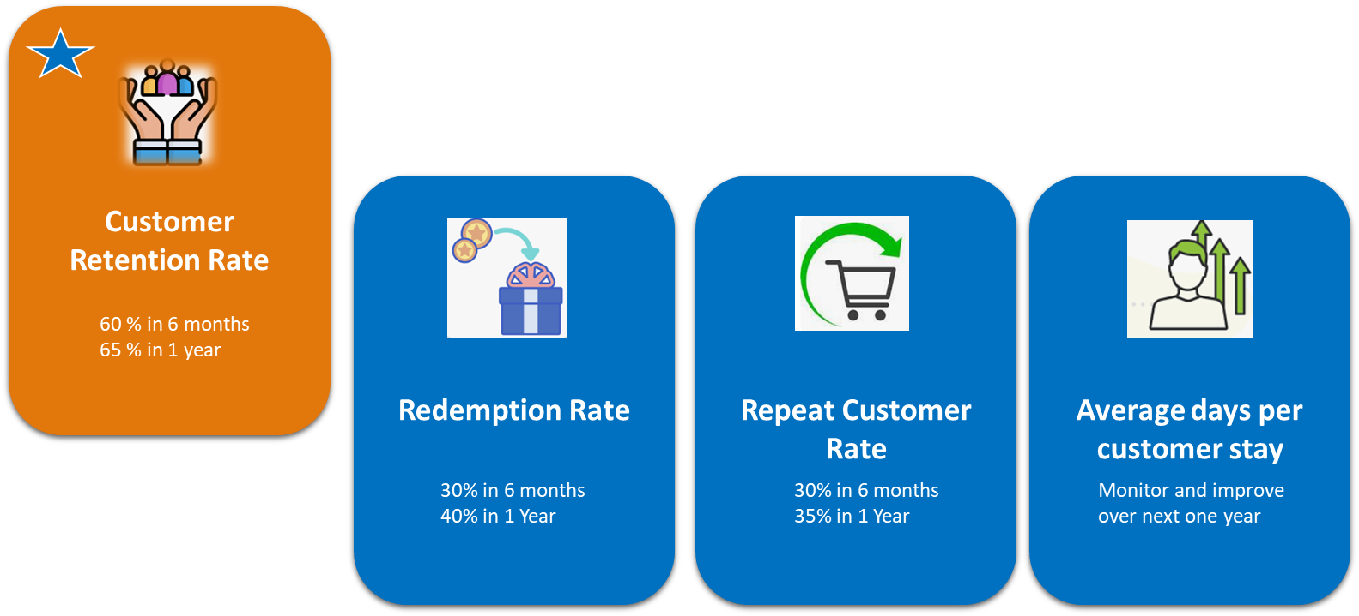
SUCCESS METRICS
60 % in 6 months
65 % in 1 year
30% in 6 months
50% in 1 Year
30% in 1 year
Monitor and improve over next one year

Slide 8
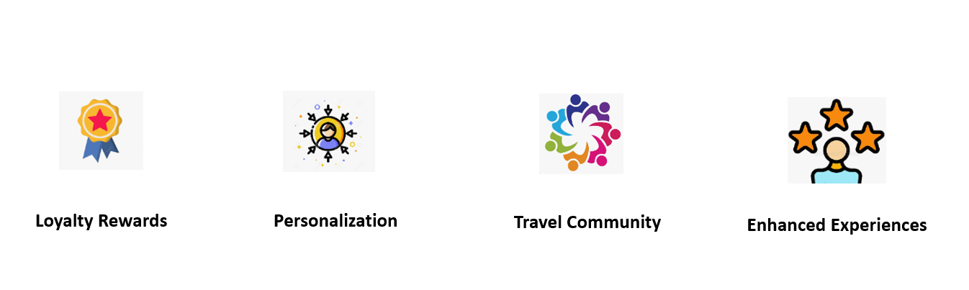
VALUE PROPOSITION

Slide 9
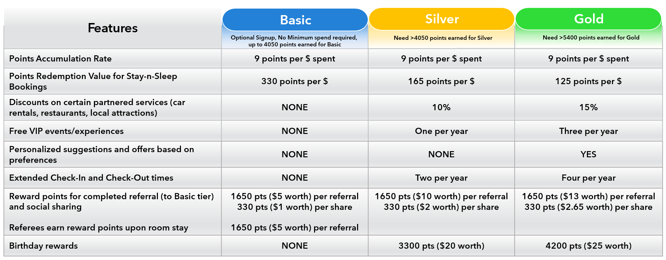
PRODUCT OFFERING
Stay-n-Sleep Elevated XP (Tiered Loyalty Reward Program):

Slide 10
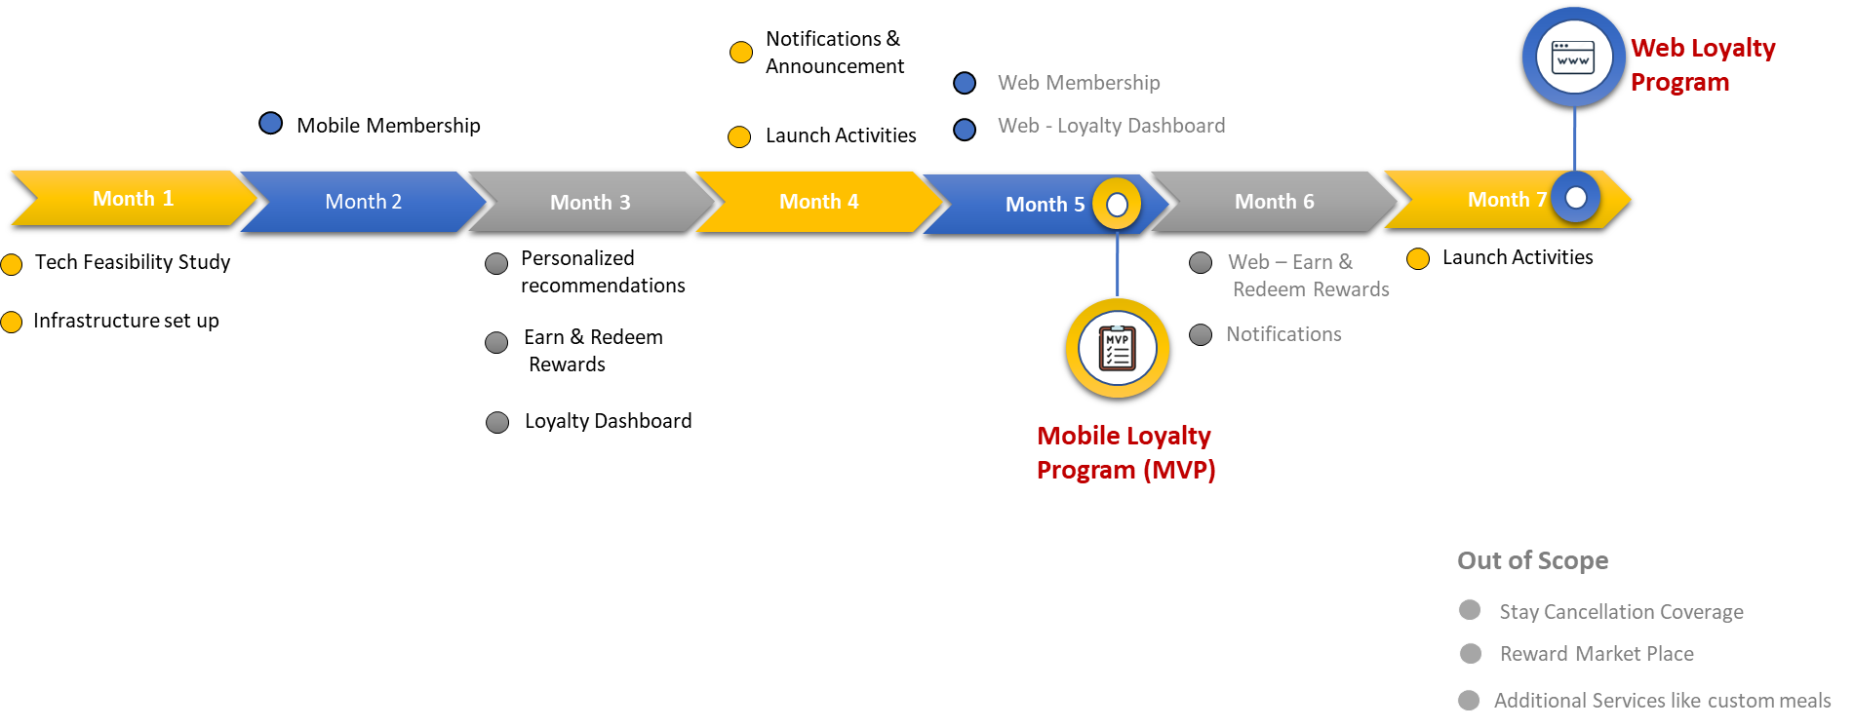
PRODUCT ROADMAP
Notes:
Here is a 6-month Product Roadmap prioritizing the Mobile version of the Loyalty program. This covered the Technical Feasibility Study, a PoC involving internal stakeholders and a combination of tech documents and wireframes. The roadmap also defined a plan for allowing user registration, access to a reward point summary for this mobile version and then quickly launching the web version of this product as well. Some features were omitted from this version since these may not directly impact user retention and also because they require more user data analytics.

Slide 11
FEATURE ROADMAP
Membership
and Rewards
Development and QA Testing complete
MVP V1 release
(Mobile version)
Month 1
Month 2
Month 3
Month 4
Month 5
Month 6
Extend Database design
Planning- Partnerships and Experiences
Customer Support Training
Engineering
Extgend Mobile Infrastructure
UI/UX Design
Extend Web Infrastructure
PM/Business Team
Release planning
User Research
Mobile Membership Registration
Marketing
Referral Feature
Project Management
Design Tiered Membership and Benefits model
Web Membership Registration
Design Mobile Profile Page and rewards Dashboard, including interactions
Web Profile Page and Rewards Dashboard
Data Gathering- Personalization feature
Redeem Rewards- Mobile
Redeem Rewards- Web
Data Analytics and Insights- Plan and Implement
Email Announcement and Notifications- Mobile
Email Announcement and Notifications- Web
Notes:
A more granular feature roadmap was defined to understand dependencies and gain alignment with other stakeholders. As it can be seen in the heavily loaded initial phases of the roadmap, we planned on developing features that we felt added most value to our customers immediately and which would provide a hassle-free booking and rewarding journey.

Slide 12
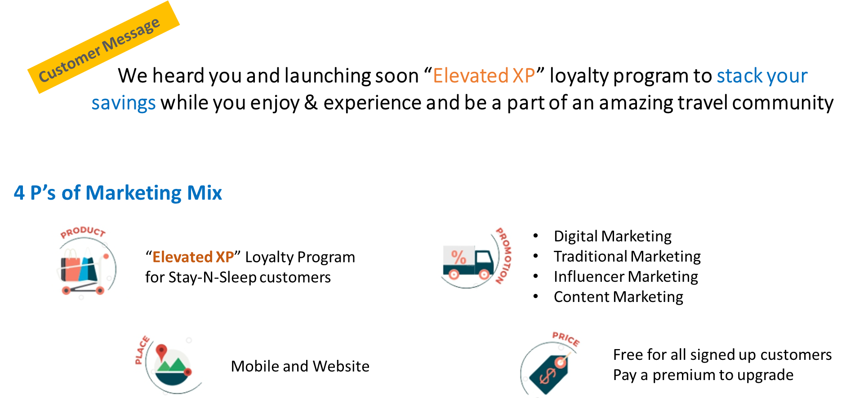
GO-TO MARKET STRATEGY

Slide 13
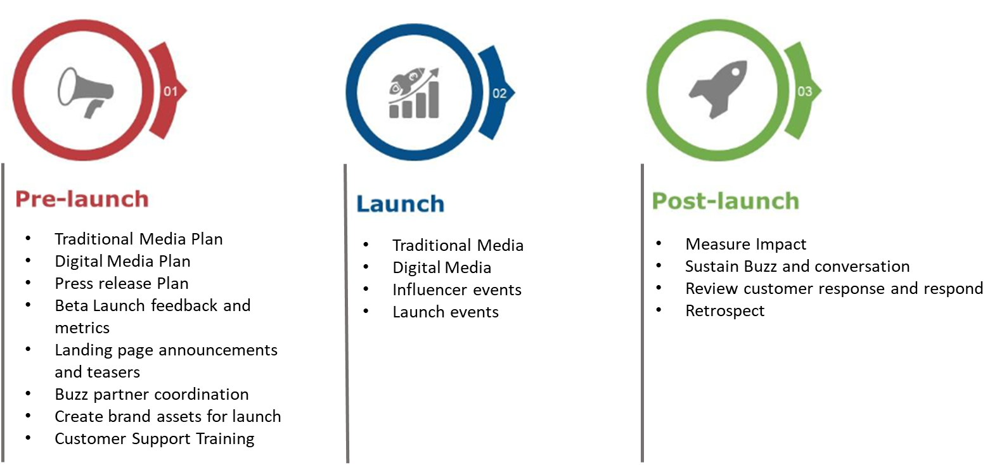
LAUNCH PLAN
Notes:
Pre-launch
Product marketing and Sales collaboration
Media Plan (Traditional and Digital)
Press release
Reach out to customers:
Landing Page announcement and teasers
SEO
Targeted Email and App Pop-ups
Engineering
Bashing the product (User testing)
Collecting feedback (Bugs and Sugs)
Metrics
External collaboration
Buzz partner coordinations
Influencers reachout
Customer Support Training and FAQ guides
Launch:
App and web go-live
Launch events
Monitor availability of service (Tech and Customer support wise)
Keep an eye on success metrics
Gather feedback: Surveys and bugs/sugs
Post Launch
Email and App campaign regarding success of the launch
Send pretty messages to customers regarding the loyalty program with initial data about number of bookings, revenue or how many people found their personalized travel recommendations.
Eg: Sally got her dream trip to Hawaii in her budget, with preferred accommodation and experiences.
Keep tracking Success metrics
Review customer response and create tickets
Retrospective
Celebrate the wins!

Slide 14
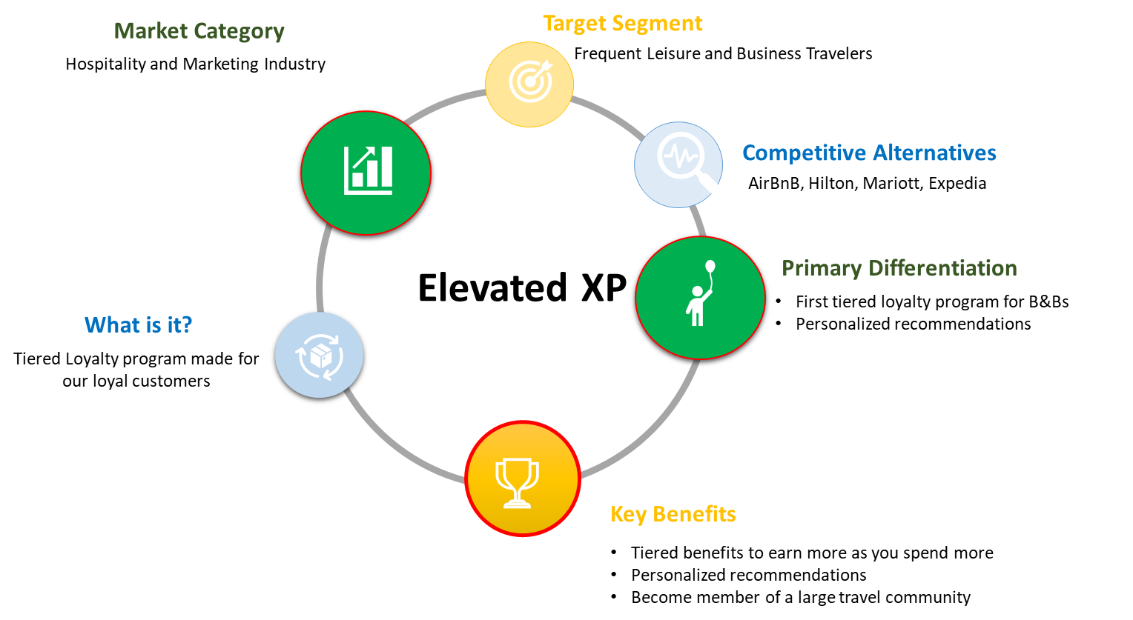
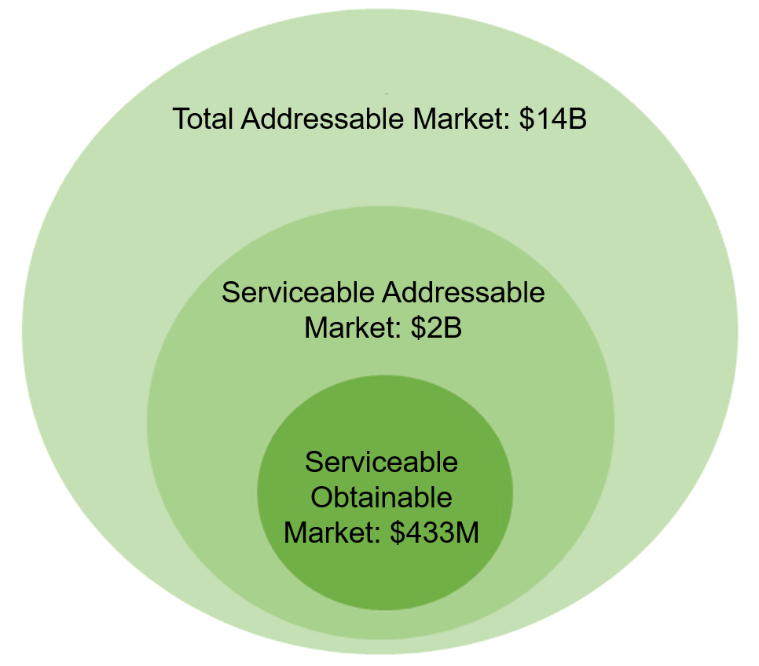
PRODUCT POSITIONING
Market Coverage Data for New York City, 2022
Notes:
As we have already discussed several aspects of the Product Positioning in the ever-growing hospitality and travel industry, we've identified a remarkable opportunity. The B&B market is ripe for transformation, and Stay-N-Sleep is here to make a difference.
What sets Elevated XP apart from the rest? We are proud pioneers of the first tiered loyalty program exclusively designed for B&Bs. Our unique approach allows customers to unlock exciting rewards as they climb up the tiers, creating a truly personalized experience.
Each tiered benefit can be enjoyed, earning more rewards and privileges as they spend more with us. Our personalized recommendation will cater to their preferences, ensuring every stay to feel tailor-made. And by joining Elevate XP, each participant would become a valued member of our large and vibrant travel community.

Slide 15
Thank You

Slide 16
Appendix

Slide 17
Detailed Personas

Slide 18
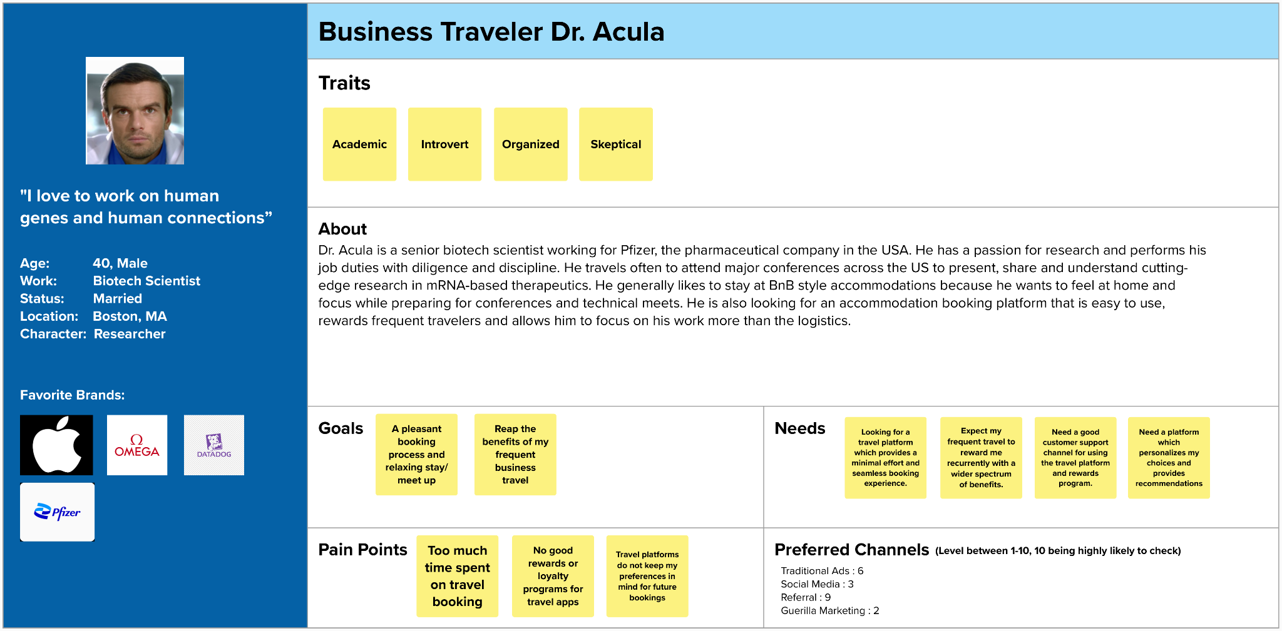

Slide 19
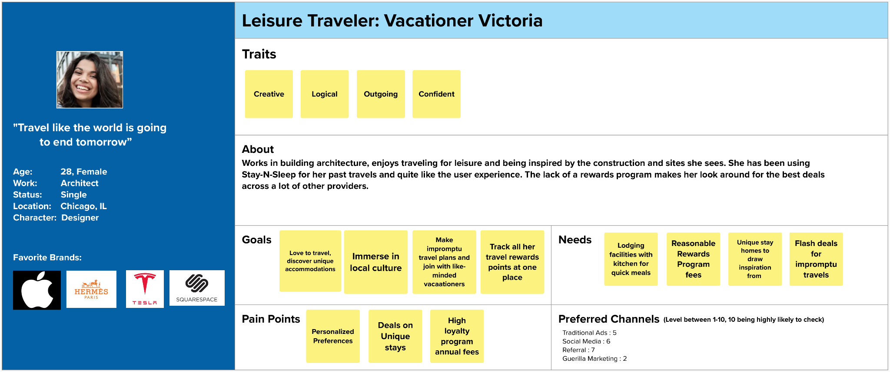

Slide 20
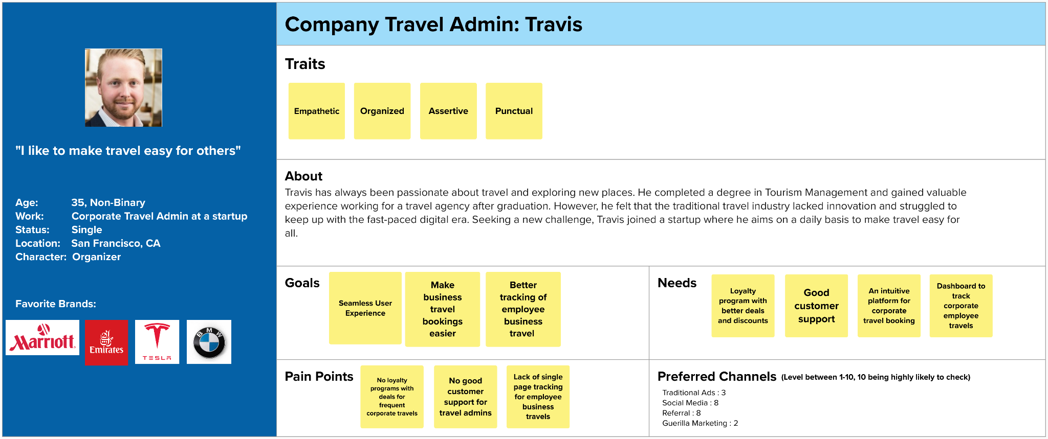

Slide 21
SYSTEM METRICS
Number of app downloads
Number of active users
Session length
Screenviews
Availability
1. User Satisfaction / Apdex Scores
2. avg response time
3. error rates:
4. Count of Application Instances
HTTP Error % – Number of web requests that ended in an error
Logged Exceptions – Number of unhandled and logged errors from your application
Thrown Exceptions – Number of exceptions that have been thrown
60 % in 6 months
65 % in 1 year
30% in 6 months
50% in 1 Year
30% in 1 year
Monitor and improve over next one year
Notes:
Number of app downloads
Number of active users
Session length
Screenviews
1. User Satisfaction / Apdex Scores
2. avg response time
3. error rates:
4. Count of Application Instances
HTTP Error % – Number of web requests that ended in an error
Logged Exceptions – Number of unhandled and logged errors from your application
Thrown Exceptions – Number of all exceptions that have been thrown

Slide 22
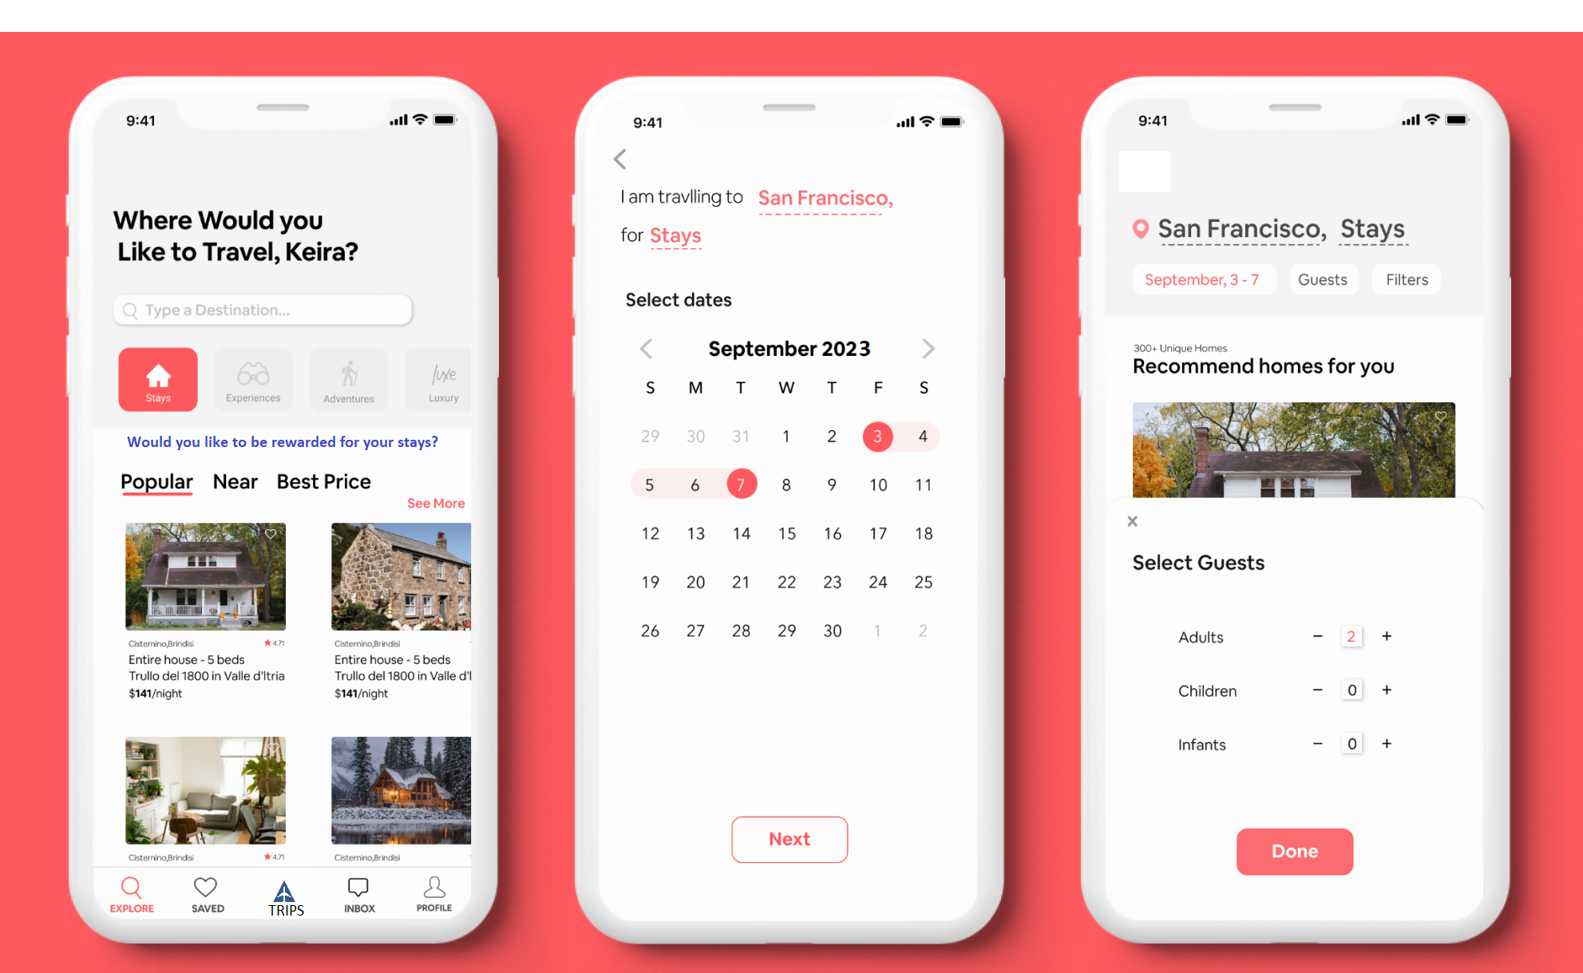
SAMPLE SCREENS
User Entry Point

Slide 23
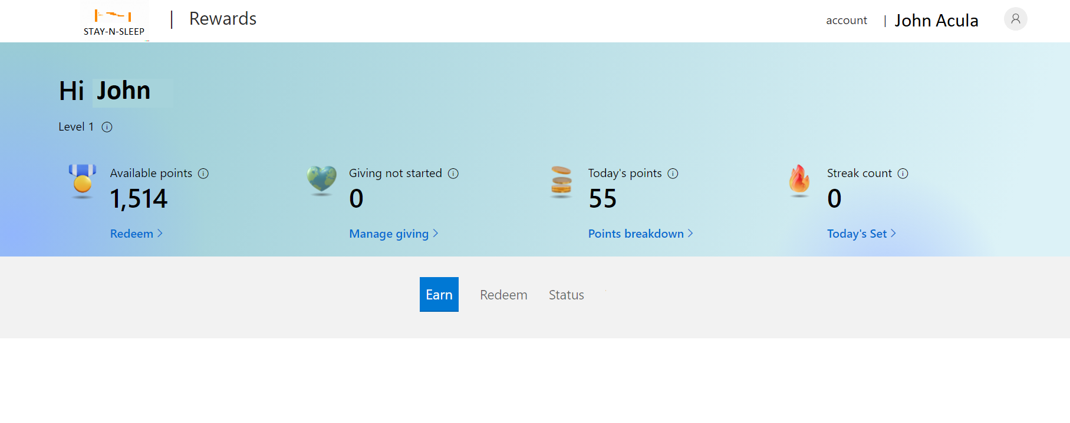
SAMPLE SCREENS

